Slide 1
Intraday Liquidity Risk management 日间流动性风险管理 Fed Net Debit Cap proposal 美联储日间净借记限额申请 Bank of china USA 中国银行纽约分行

Slide 2
Executive Summary 概要
Per Fed Payment System Risk Policy, each institution incurring daylight overdrafts in its Federal Reserve account must adopt a net debit cap, that is, a ceiling on the total daylight overdraft position that it can incur during any given day.
根据美联储支付系统风险政策，每个美联储账户可能发生日间透支的机构须采用净借记限额，此上限为任何一天该机构可能发生的日间透支总额。
Per BOCNY Liquidity Risk Management Policy, the Bank shall ensure it has enough intraday liquidity positions and relevant financing arrangements to meet the intraday payment demands against normal conditions and under stress scenarios. Net debit cap is part of the intraday funding sources as the last resort for daylight overdraft.
根据纽行流动性风险管理政策，纽行应确保拥有足够的日间流动性和相关的融资安排以满足基本及压力情景下的日间支付需求。净借记限额作为日间资金来源的其中一种，是日间透支的最终手段。
Current net debit cap is “Above Average” cap, or $43.3Bn in daylight overdraft capacity.
目前纽行的净借记限额类别为“Above Average”，日间透支额度为433亿美元。
In the past, net debit cap is never used. However the Bank spent lots of time and efforts in the required self-assessment for renewing the net debit cap category Average or Above Average.
历史上纽行从未出现过使用净借记限额的情况。但为延续“Average”或“Above Average”类别透支额度，纽行每年花费了大量时间和精力完成其要求的自我评估报告。
Our current recommendation is to apply for “De Minimis” cap.
经分析，建议纽行申请额度较低的“De Minimis”类别。
Much simpler process: no self-assessment required, only board resolution needed;
更为简捷的申请过程：只需董事会决议，不需要完成自我评估报告。
Provides sufficient daylight overdraft capacity or $9.28Bn (*).
该档可提供足够的日间透支额度 ，约为92.8亿美元 (*)。
(*) Note– based on current BOC group capital, confirmed with Fed.
(*)注– 根据目前中国银行集团的资本金，已与美联储确认。

Slide 3
Fed Net Debit Cap Analysis Framework
美联储净借记限额分析框架
Fed Net Debit Cap Analysis
美联储净借记限额分析
Goal: Which cap category is more appropriate for BOCNY?
目标：评估纽行适用的日间透支限额类别
Approaches:
方法 ：
1.1. Historical data statistical analysis
历史数据统计分析
1.2. Recent trend and future business needs
近期趋势及未来业务需求
Conclusion & Recommendation
结论及建议
Next Steps
下一步工作

Slide 4
Fed Net Debit Cap Analysis – Overall Decision Framework
美联储净借记限额分析 – 总体决策框架
Framework
框架
Approach 1: Historical Data Statistical Analysis
方法1：历史数据统计分析
Total intraday inflow and outflow distribution 日间流入和流出总额分布
Fed account beginning balance distribution 美联储账户起始余额分布
Estimate the intraday funding gap from 1) & 2) 根据1）& 2）预估日间资金缺口
Other factors --Seasonality & holiday effect 其他因素– 季节性及节假日影响
Approach 2: Recent Trend and Business Needs
方法2：近期趋势及未来业务需求
Recent Balance Trend 近期余额趋势
Intraday and overnight overdraft limits 日间及隔夜透支限额
Major clients’ limit usage 主要客户的限额使用
Net Debit Cap Category
( Average & Above?) Average及以上类别
Yes
Self-Assessment自我评估
No
Category (Zero, Exempt from filing, De minimis)
较低类别

Slide 5
1.1 Historical Data Statistical Analysis 历史数据统计分析
Historical Inflow and Outflow Distribution 历史流入和流出分布
The analysis is based on the Fed account inflows and outflows from the past three years (754 Days). 该分析是基于过去三年（754天）的美联储账户流入和流出。 5% Percentile of inflows: $3,008,947,159.20 1% Percentile of inflows: $1,767,876,541.21 5% Percentile of outflows: $(21,639,350,132.92) 1% Percentile of outflows: $(29,054,989,754.21) Net Intraday Flow日间净流出 $(18,630,402,973.72) $(27,287,113,213.00)
Total Inflows 总流入
Range 范围 | Frequency (# of Days)频率 | Normal Distribution 正态分布 | Cumulative # of Days 累计天数 | Total # of Days总天数 | Probability 概率
$1,500,000,000.00 | 3 | 0.00000000002 | 3 | 754 | 0%
$3,000,000,000.00 | 35 | 0.00000000003 | 38 |  | 5%
$5,000,000,000.00 | 89 | 0.00000000005 | 127 |  | 17%
$7,500,000,000.00 | 155 | 0.00000000006 | 282 |  | 37%
$10,000,000,000.00 | 144 | 0.00000000007 | 426 |  | 56%
$12,500,000,000.00 | 105 | 0.00000000006 | 531 |  | 70%
$15,000,000,000.00 | 81 | 0.00000000005 | 612 |  | 81%
$20,000,000,000.00 | 90 | 0.00000000002 | 702 |  | 93%
$25,000,000,000.00 | 39 | 0.00000000000 | 741 |  | 98%
$35,000,000,000.00 | 13 | 0.00000000000 | 754 |  | 100%
Total Outflows 总流出
Range 范围 | Frequency (# of Days)频率 | Normal Distribution 正态分布 | Cumulative # of Days 累计天数 | Total # of Days 总天数 | Probability 概率
($30,000,000,000.00) | 7 | 0.00000000000 | 7 | 754 | 1%
($25,000,000,000.00) | 11 | 0.00000000000 | 18 |  | 2%
($20,000,000,000.00) | 34 | 0.00000000002 | 52 |  | 7%
($15,000,000,000.00) | 99 | 0.00000000005 | 151 |  | 20%
($10,000,000,000.00) | 175 | 0.00000000007 | 326 |  | 43%
($7,500,000,000.00) | 131 | 0.00000000006 | 457 |  | 61%
($5,000,000,000.00) | 160 | 0.00000000005 | 617 |  | 82%
($2,500,000,000.00) | 108 | 0.00000000003 | 725 |  | 96%
$0.00 | 29 | 0.00000000002 | 754 |  | 100%

Slide 6
1.1 Historical Data Statistical Analysis 历史数据统计分析
Fed Account Historical Balance Distribution 美联储账户起始余额分布
Funding gap is $6.3Bn at 1% percentile. 第1百分位数的资金缺口为约为63亿。
No Funding gap at 5% percentile. 第5百分位数无资金缺口。
1% Percentile Beginning Balance 日初余额: $ 21,002,906,120.42
Net Intraday Flow 日间净流入: $ (27,287,113,213.00)
EoD Balance 日末余额: $ (6,284,207,092.58)
5% Percentile Beginning Balance 日初余额: $ 24,940,886,426.72
Net Intraday Flow 日间净流入: $ (18,630,402,973.72)
EoD Balance 日末余额: $ 6,310,483,453.00

Slide 7
1.1 Other Factor – Seasonality/Holiday Effects 其它因素 - 季节性及节假日影响
1.1 Historical Data Statistical Analysis 历史数据统计分析
Based on past three years' historical data, the volatilities usually happen at month ends. The greatest volatilities occur at month ends of 2014 October, 2015 January, March and September and 2016 September. The intraday funding gap will likely occur on the month-end, quarter-end, holidays, significant market events (such as RMB FX rates intervention) or unexpected large payments 基于过去三年的历史数据，余额波动通常发生在月末。最大的波动发生于2014年10月、2015年1月、3月、9月及2016年9月。日间资金缺口一般出现在月末、季度末、节假日、市场重大事件（如人民币汇率干预）或未预期的大额付款时。

Slide 8
Approach 1 – Analysis Conclusion 方法1 - 分析结论
1.1 Historical Data Statistical Analysis 历史数据统计分析
The Net Debit Cap Category “De Minimis” capacity $9.28Bn is sufficient to cover the $6.3Bn funding gap (only 1% chance per historical data)
若申请净借记限额“De Minimis”类别，纽行的透支额度约为92.8亿美元，足以满足63亿美元的资金缺口（基于历史数据1%的概率）。
Limitation 方法缺陷:
The history does not predict future, as the Bank may change its business strategy. The future situation may not be the same as in the past.
纽行未来可能改变业务战略，历史数据不能准确预测未来。
Therefore, the current trend and future needs should be analyzed.
因此有必要分析纽行近期趋势及未来业务需求。

Slide 9
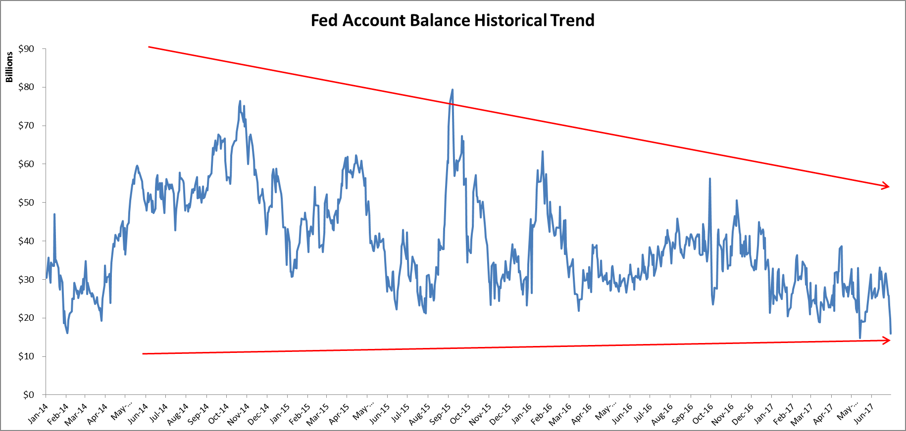
1.2 Recent Trend and Future Business Needs 近期趋势及未来业务需求
Fed account balance peak trend downward from $70Bn to $40Bn.
美联储账户余额峰值呈下降趋势，从700亿美元降到400亿美元。
The lowest balance touched below $15Bn recently.
近期美联储账户最低余额出现过低于150亿的情况。
The Fed account balance estimated ranging from $15Bn to $35Bn.
美联储账户余额预计为150亿美元到 350亿美元。
Lowest Fed account balance over past three years:
过去三年美联储账户最低余额：
2017 May 12th : $14.7Bn
2017年5月12日：147亿美元
2017 June 30th: $15.9Bn
2017年6月30日：159亿美元
Lowest balance points
账户最低点

Slide 10
1.2 Recent Trend and Future Business Needs 近期趋势及未来业务需求
Recent Case Lowest Balance Day - May 12th , 2017
近期日间最低余额 – 2017年5月12日
Billions
May 12th has the lowest Fed account ending balance ($14.7Bn) over past three years.
过去三年中美联储账户最低余额发生在2017年5月12日，约为147亿美元。
Worst intraday balance ($11.2Bn) occurred at around 12:30 PM.
最低日间余额发生在12：30PM，约为112亿美元。
$10Bn outflow
100亿美元流出
12: 30 PM $11,288,451,901.00
Data source: Fed Account Transaction End-of-minute Detail Report from CLD
数据来源：清算部美联储账户交易明细报告

Slide 11
1.2 Recent Trend and Future Business Needs 近期趋势及未来业务需求
Recent Case Lowest Balance Day - June 30th , 2017
2017 近期日间最低余额 – 2017年6月30日
Worst intraday balance occurred at around 5 AM to 6AM
最低日间余额发生在5AM 至 6AM
5: 05 AM $13,364,844,962.00
Data source: Fed Account Transaction End-of-minute Detail Report from CLD
数据来源：清算部美联储账户交易明细报告

Slide 12
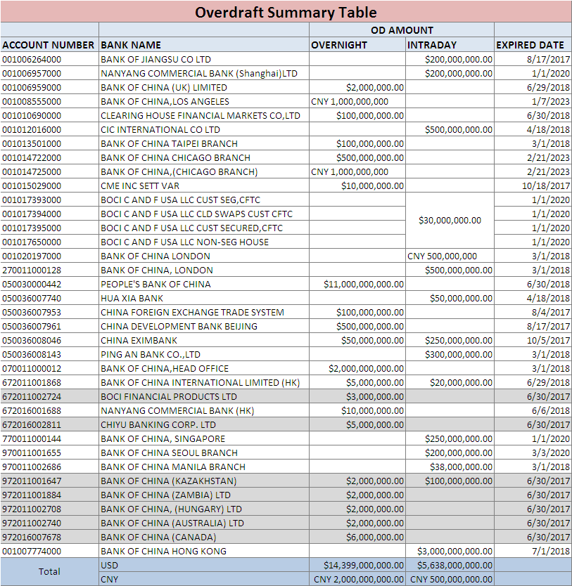
1.2 Recent Trend and Future Business Needs 近期趋势及未来业务需求
The Bank approved total $20Bn ($14.4Bn OD, $5.6Bn intraday) Overdraft Limit.
纽行共向客户提供200亿美元透支额度（其中144亿美元为隔夜透支额度，56亿美元为日间透支额度）。
The limit usage will significantly impact the Bank’s intraday liquidity especially from the large clients PBOC, BOC HK and BOC HO
透支额度的使用将影响纽行的日间流动性。影响较大的客户包括中国人民银行、中银香港和中国银行总行。
Source: GPS system
数据来源：GPS系统

Slide 13
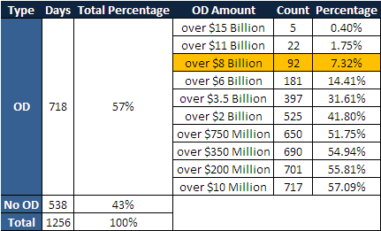
1.2 Recent Trend and Future Business Needs 近期趋势及未来业务需求
Largest Client Actual Overdraft Usage – PBOC
大客户实际透支额使用 - 中国人民银行
At 5% chance, PBOC will use overdraft about ~$10Bn
5%的概率下 中国人民银行将使用约100亿美元透支额度
Clearing Department has recorded daily real-time balances at 5 a.m. since September 2011 as customers in China usually had the lowest balances around that time.
自2011年9月起清算部每天记录凌晨5点的实时余额。该时点通常为中国客户余额最低时间。
In a total of 1256 business days starting from September 2011, PBOC had negative balances in 57% days ranging from $10M to $15Bn.
自2011年9月起的1256个工作日，中国人民银行有57%的天数凌晨5点时账户实时余额为负数，余额范围为负150亿至负1,000万美元。
Data source: Fed Account Transaction End-of-minute Detail Report from CLD
数据来源：清算部美联储账户交易细明细报告

Slide 14
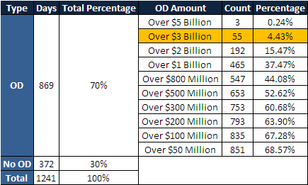
1.2 Recent Trend and Future Business Needs 近期趋势及未来业务需求
Largest Client Actual Overdraft Usage – BOC HK
大客户实际透支额使用 - 中银香港
At 5% chance, BOC HK will use overdraft about ~$2.8Bn
5%的概率下 中银香港将使用约28亿美元的透支额度
In a total of 1241 business days starting from September 2011, BOC HK had negative balances in 70% days ranging from $50M to $5Bn.
自2011年9月起的1241个工作日，中银香港有70%的天数凌晨5点时账户实时余额为负数，余额范围为负50亿至负5,000万美元。
Data source: Fed Account Transaction End-of-minute Detail Report from CLD
数据来源：清算部美联储账户交易明细报告

Slide 15
Approach 2 – Analysis Conclusion 方法2 - 分析结果
1.2 Recent Trend and Future Business Needs 近期趋势及未来业务需求
Net Debit Cap category “De Minimis” capacity $9.28Bn is sufficient to cover the future business needs in very extreme cases. 净借记限额“De Minimis”类别透支额度约为92.8亿美元，足以满足未来极端情况下的业务需求。
Funding Sources 资金来源
1) Fed Account Balance $15Bn (recent lowest); plus 美联储账户余额 150亿美元（近期最低）；
2) “De Minimis” Cap $9.2Bn “De Minimis”额度，约92亿美元
Funding Needs 资金需求
Assume clients use all the overdraft limits total ~$20Bn approved.
假设客户使用了纽行已批的全部透支额度200亿美元
>
$24.2Bn
约242亿美元
~$20Bn
约200亿美元
Limitation 方法缺陷
The future is difficult to predict, this is the worse scenario we can foresee.
未来难以预测，这是目前可预见的最糟情况。
Recommendation 建议
Total overdraft limits should be lower than the minimum Fed balance ($15Bn).
总透支额度应低于美联储历史最低账户余额（150亿美元）。
Overdraft limits thresholds and the methodology need to be further reviewed.
透支额度的设定及其方法论有待进一步审核。

Slide 16
2. Conclusion and Recommendation 结论及建议
Analysis
Results
分析结果
Historical analysis concludes the cap Category “De Minimis” capacity $9.28Bn is sufficient to cover $6.3Bn funding gap (only at 1% probability) 历史数据分析结果显示 ，“De Minimis”类别提供的透支额度（约92.8亿美元）足以满足63亿美元的资金缺口（基于历史数据1%的概率）。
Current trend and future business needs also concludes “De Minimis” capacity is still sufficient to cover the all overdraft limit usage ~$20Bn in a very extreme case. 近期趋势及未来业务需求分析显示“De Minimis”类别透支额度仍足以满足未来极端情况下200亿美元透支额度的使用。
Recommend to Apply for Fed Net Debit Cap Category
“De Minimis”
建议申请“De Minimis”类别

Slide 17
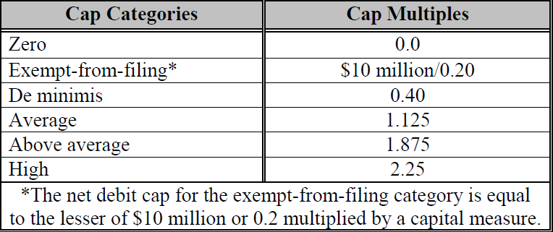
Fed Net Debit Cap Category and Requirements 美联储净借记限额类别要求
2. Conclusion and Recommendation 结论及建议
Requirements
要求
No filing requirements
无需申请文件
Board resolution only
董事会决议
Board resolution &
Self-assessment
董事会决议及自我评估
The cap category and capital measure determine the size of its net debit cap.
净借记限额的额度由类别及资本金决定。
Net debit cap = cap multiple * capital measure
Net debit cap = 类别乘数 * 资本金
Current cap category for BOCNY - Above Average at $43.3Bn.
纽行目前的类别为“Above Average”，透支额度为433亿美元。

Slide 18
2. Conclusion and Recommendation 结论及建议
Fed Net Debit Cap Category Capacity 美联储 净借记限额类别额度
Net debit cap = cap multiple * capital measure
Net debit cap = 类别乘数 * 资本金
2016 Year-end (in $Billions) 2016年年末数据（单位：十亿美元） | De Minimis (Proposed) 建议类别 De Minimis | Above Average (Current) 目前类别 Above Average
Amount of Bank‘s Daylight Overdraft Capital Base 集团日间透支资本基数 | $ 232Bn | $ 232Bn
*10% (Ratio for FBOs that are not FHCs and are ranked a SOSA 2) 10%（非金融控股公司并拥有SOSA2评级的外国银行适用的比例） | * 10% | * 10%
Capital Measure 资本金 | $ 23.2Bn | $ 23.2Bn
* Cap Multiple 类别乘数 | * 0.4 | * 1.875
Net Debit Cap | $ 9.3Bn | $ 43.3Bn
Note: BOCNY is not capitalized independently. Capital measure used here is determined by BOC group’s daylight overdraft capital base, which is from FR 2225 report submitted to Fed.
注：纽行没有独立资本金。此处资本金取决于中国银行集团日间透支资本基数。该基数通过FR2225报告向美联储提交。

Slide 19
2. Conclusion and Recommendation 结论及建议
De Minimis Requirement “De Minimis” 类别要求
De Minimis
Many institutions incur relatively small overdrafts and thus pose little risk to the Federal Reserve. To ease the burden on these small overdrafters of engaging in the self-assessment process and to ease the burden on the Federal Reserve of administering caps, the Board allows institutions that meet reasonable safety and soundness standards to incur de minimis amounts of daylight overdrafts without performing a self-assessment. An institution may incur daylight overdrafts of up to 40 percent of its capital measure if the institution submits a board of directors resolution.
许多机构发生的透支相对较小，因此对美联储造成的风险较低。为了减轻自我评估过程对于产生较小透支机构的负担及美联储管理的负担，美联储允许满足相对安全稳健要求的机构使用较小的“De Minimis”日间透支额度且无需进行自我评估。机构提交董事会决议后，最高日间透支额度可达资本量的40%。
An institution with a de minimis cap must submit to its Reserve Bank at least once in each 12-month period a copy of its board of directors resolution (or a resolution by its holding company’s board) approving the institution’s use of intraday credit up to the de minimis level. The Reserve Banks will review the status of any institution with a de minimis net debit cap that exceeds its net debit cap during a two-week reserve-maintenance period and will decide if additional action should be taken (see section II.G.).
需申请“De Minimis”类别透支额度的机构需至少每12个月向美联储提交一份董事会决议（或其控股公司董事会的决议），批准该机构使用不超过“De Minimis”类别的透支额度。如有机构在两周的准备金提存期间透支额超过其净借记限额，美联储将审查该机构状态并决定是否需要采取额外行动（详情参考政策2.G.）。
Source: Federal Reserve Policy on Payment System Risk, page 23
来源： 美联储支付系统风险政策，第23页

Slide 20
3. Next Steps 下一步工作
Fed Net Debit Cap Application 美联储净借记限额申请
Obtain BOC group board’s approval of the Resolution
获取中国银行董事会决议
Submit the board approved Resolution to Fed by September 26, 2017
在2017年9月26日前向美联储提交批准后的董事会决议
Enhance Related Intraday Liquidity Management 加强相关日间流动性管理
Improve and implement the procedure related BOCNY Net Debit Cap Application
加强并实施纽行净借记限额申请的相关流程
Clearly define the roles & responsibilities
明确定义职责与分工
Formalize the process of analysis and self-assessment (if needed)
如需要，完善分析及自我评估的相关流程
Implement net debit cap into CLD’s daily monitoring process
将净借记限额融入清算部的每日监控流程
Include net debit cap to bank’s funding sources
将净借记限额列入纽行的融资来源

